Slide 1



ASBCB Omics Codeathon 7-10 October 2021
باسم الله الرحمن الرحيم والصلاة والسلام على رسول الله
In silico analysis of the single nucleotide polymorphisms of human hepatitis B and D viruses in Sudan
Research Team
Osama Mohammed, Sabah Ibrahim, Sumaya Kambal, Esra A. Abdalwhab, Arwa Ibrahim, Sowole Adekunle Damilola, Adam Yagoub, Situma Victor Wekesa, Sofia B. Mohamed

Slide 2
Background
Hepatitis B virus (HBV) infection is one of the major causes of liver cirrhosis and hepatocellular carcinoma.
Hepatitis D (HDV) infection causes a more severe disease than mono infection with HBV. It is considered a serious, neglected disease, particularly in developing countries.
As a result of nucleic acid sequence variation, there are ten recognized HBV genotypes which have distinct geographical distributions. These genotypes influence the clinical outcomes, complications and response to treatment of HBV infection.
The role of SNPs in HBV and HDV infection and associated genotypes in the Sudanese population remains unclear.

Slide 3
Objectives
1- Study the current distribution of HBV and HDV genotypes in Sudan.
2- Investigate the nucleotide diversity between genotypes.
3- Identify mutations that lead to Occult HBV infections (OBI).
4- Predict the effect of amino acid variants on the large delta antigen and polymerase proteins function.
5- Assess the association between the SNPs and liver cirrhosis and hepatocellular carcinoma.

Slide 4
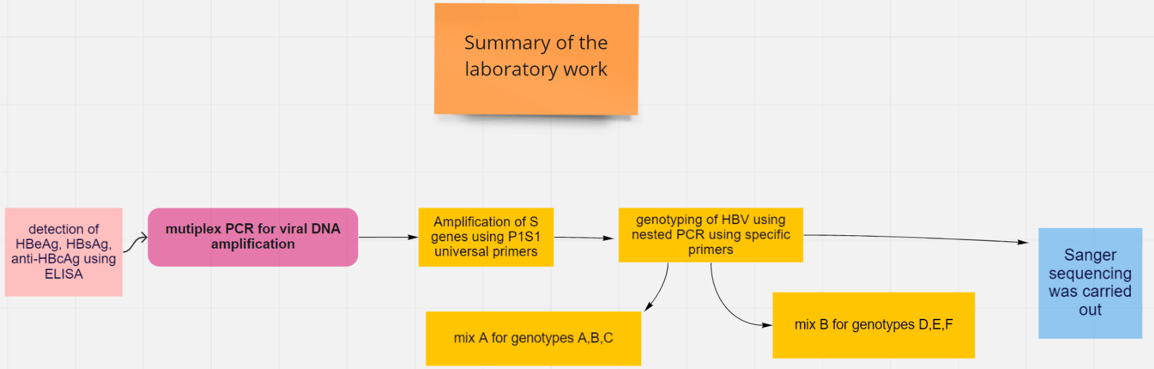

Slide 5
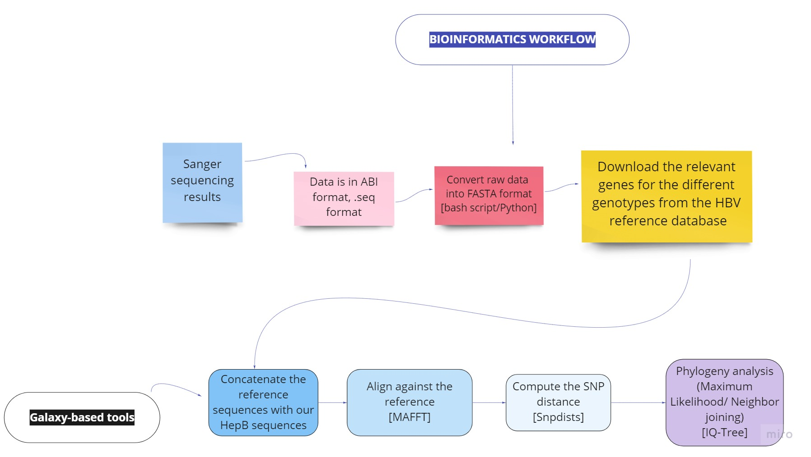

Slide 6
Thank you!

Slide 7
References
1- Daw MA, Daw AM, Sifennasr NEM, et al. The Epidemiology of Hepatitis D Virus in North Africa: A Systematic Review and Meta-Analysis. ScientificWorldJournal. 2018;2018:9312650. Published 2018 Sep 26. doi:10.1155/2018/9312650
2- Mohmed Khair O M, Enan K A A, Hussien M O, Mohammed A A A, Bozdayi M A, et al. Seroprevalence and Molecular Detection of Hepatitis Delta Virus (HDV) Among Hemodialysis Patients and Blood Donors in a Cross-Sectional Study in Khartoum State, Sudan, Int J Infect. 2016 ; 3(3):e35391. doi: 10.17795/iji-35391.
3-Kim, H.; Lee, S.A.; Do, S.Y.; Kim, B.J. Precore/core region mutations of hepatitis b virus related to clinical severity. World J. Gastroenterol. 2016, 22, 4287–4296.
4-McNaughton, A.L.; D’arienzo, V.; Ansari, M.A.; Lumley, S.F.; Littlejohn, M.; Revill, P.; McKeating, J.A.; Matthews, P.C. Insights from deep sequencing of the hbv genome—Unique, tiny, and isunderstood Gastroenterology 2019, 156, 384–399.

